Slide 1
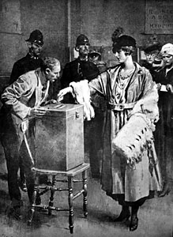
Mill II: Representative Democracy and Equality of the Sexes
Politics 2A
Dr Carl Knight, Lecturer in Political Theory

Slide 2
ARE FORMS OF GOVERNMENT CHOSEN?
Start of Mill’s Considerations on Representative Government assesses 2 views: one says govt can be designed like a machine (Bentham), the other that it’s a ‘spontaneous product’ & political science is ‘a branch… of natural history’ (Coleridge)
Mill says neither is plausible by itself: ‘No one believes that every people is capable of working every sort of institutions’ nor that ‘mankind have absolutely no range of choice as to the government’. Choice but not in circumstances of choosing (Marx)?

Slide 3
POWER
Some say that govt is ‘fixed and determined beforehand by the state of the country in regard to the distribution of the elements of social power’.
Element of truth to this but what’s meant by power?
Muscular strength? Property? Intellect?
Those weak in these respects dominate if organized
Political power achieved through active power. Belief & thought ‘acts on the will’: ‘1 person with a belief, is a social power equal to 99 who have only interests’

Slide 4
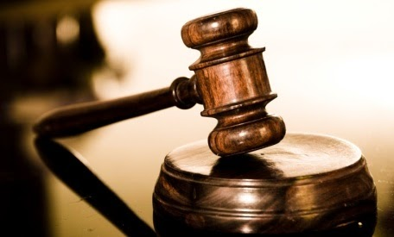

CRITERIA FOR ASSESSING GOVERNMENT FORMS
Coleridge & Comte suggest Order and Progress
‘it would be more philosophically correct to leave out of the definition the word Order, and to say that the best government is that which is most conducive to Progress’ (ch. 2). E.g. police facilitate progress.
But Progress alone gives “a very insufficient idea of the importance of the strivings which take place to improve and elevate human nature and life, to suppose that their chief value consists in the amount of actual improvement realized by their means, and that the consequences of their cessation would merely be that we should remain as we are”

Slide 5
TWO CRITERIA FOR GOVERNMENTS
1st: ‘the most important point of excellence which any form of government can possess is to promote the virtue and intelligence of the people themselves’
2nd: ‘the degree in which it is adapted to take advantage of the amount of good qualities [of persons] which may at any time exist, and make them instrumental to the right purposes’
These interact - e.g. a judicial procedure adapted to citizens’ characters will improve justice of decisions (2nd criterion), and may increase their capacities (1st)

Slide 6
STATES OF SOCIETY
So far Mill has established that a govt can be chosen & the grounds on which it should be chosen
Next step is to ask which form of government is best
But as we’ve seen, Mill thinks govt must be matched to character of the people, so really 2 questions
Which govt best for the existing stage of society?
Which is the ideal form of government?
Must answer (2) to answer (1) so we understand the steps society must go through to reach ultimate goal

Slide 7

BENEVOLENT DESPOTISM
Common ideal is the benevolent and capable despot
Even if technical trouble (e.g. despot’s time, able deputies) overcome, despot would fail Mill’s criteria
‘What sort of human beings can be formed under such a regime? What development can either their thinking or their active faculties attain under it?’
People lose reasons for deliberating: ‘A person must have a very unusual taste for intellectual exercise in and for itself, who will put himself to the trouble of thought when it is to have no outward effect’ (ch. 3)

Slide 8
THE END OF A DESPOT
Not just intellect that’s undermined - solidarity too: ‘Let a person have nothing to do for his country, and he will not care for it’
Stagnation arises with surpluses consumed privately
Ultimately collapsed ‘either by a stronger despot, or by the nearest barbarous people who retain along with their savage rudeness the energies of freedom’
Despot might try to retain this energy (free press, council, etc) but this is just representation lite

Slide 9
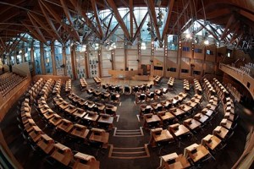
REPRESENTATIVE GOVERNMENT
‘There is no difficulty in showing that the ideally best form of government is that in which the sovereignty, or supreme controlling power in the last resort, is vested in the entire aggregate of the community; every citizen not only having a voice in the exercise of that ultimate sovereignty, but being, at least occasionally, called on to take an actual part in the government, by the personal discharge of some public function, local or general’

Slide 10
EXISTING SOCIETY
Representative government best adapted for existing society (2nd criterion):
(1) ‘the rights and interests of every or any person are only secure from being disregarded, when the person interested is himself able, and habitually disposed, to stand up for them’. E.g. working class representation.
(2) ‘the general prosperity attains a greater height, and is more widely diffused, in proportion to the amount and variety of the personal energies enlisted in promoting it’

Slide 11

EDUCATION OF SOCIETY
Rep govt promotes virtue and intelligence. Why? After all, people seem to prefer passive characteristics in others
But Bentham’s mental excellences – intellectual, practical and moral – all result from active effort
Rep govt encourages active citizens:
‘as fully privileged as any other’=‘invigorating effect’
the act of participation itself is educative.

Slide 12
GOVERNMENT AND PEOPLE
What circumstances does a form of govt need?
‘political machinery … needs, not their simple acquiescence, but their active participation; and must be adjusted to the capacities and qualities of such men as are available’ (ch. 1)
Hence people must be (1) Willing to accept govt form
(2) Willing & able to do what’s needed to maintain it
(3) “ “ “ to do what’s needed for it to fulfil its function

Slide 13
WHEN REPRESENTATIVE GOVERNMENT IS INAPPLICABLE
Less developed people less suitable for rep govt
It cannot persist in absence of three necessary characteristics in people, e.g., where there’s (1) indifference rather than acceptance of rep govt, (2) no fight to resist executive, or (3) use of position to pursue private fortunes rather than public interest
Other cases where rep govt possible but kingly government better option to train people, e.g., (1) in obedience or out of (2) passivity and (3) localism

Slide 14
THE FUNCTIONS OF REPRESENTATIVE BODIES
‘the whole people, or some numerous portion of them, exercise through deputies periodically elected by themselves, the ultimate controlling power’ (ch. 5)
‘a numerous assembly is as little fitted for the direct business of legislation as for that of administration. There is hardly any kind of intellectual work which so much needs to be done not only by experienced and exercised minds, but by minds trained to the task through long and labourious study’.
‘Commission of Legislation’ drafts laws for approval

Slide 15
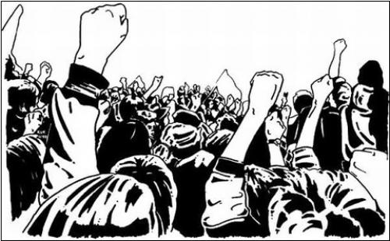
DANGERS OF REPRESENTATIVE GOVERNMENT
Shortfall of intelligence and knowledge in the people and assembly (especially compared to bureaucracy)
‘Sinister interests’ conflicting with general interest: e.g. racial groups, religions, class
Mill’s solutions: (1) proportional representation; and (2) make class interests ‘equally balanced, each influencing about an equal number of votes in parliament’ (!). We look at these in turn.

Slide 16
TRUE AND FALSE DEMOCRACY
‘Pure idea’ – ‘government of whole people by the whole people, equally represented’ (ch. 7)
‘Democracy as commonly conceived and hitherto practiced, is the government of the whole people by a mere majority of the people, exclusively represented’ – i.e. under first-past-the-post system
Power to ‘majority of majority’ (often minority). Majority of parliament which is elected by majority (!)
Mill instead defends Hare’s plan for proportional representation (single transferable vote)

Slide 17
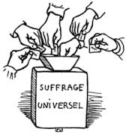
THE EXTENSION OF THE SUFFRAGE
Even with proportional representation, ‘absolute power, if they chose to exercise it, would rest with the numerical majority; and these would be composed exclusively of a single class, alike in biases, prepossessions, and general modes of thinking, and a class, to say no more, not the most highly cultivated’ (ch. 8).
Objectives: Majority not able to dominate others, but advantages of popular govt retained

Slide 18
PLURAL VOTING
Restriction of franchise not an option: undermines education of ‘lower ranks’ – cf. ‘cultivated intelligence’ of Americans (de Tocqueville)
Except illiterate, innumerate, debtors & ‘parish relief’!
Unjust to exclude voice of a person with same interests, but don’t need equal voice: ‘the wiser or better man, has a claim to superior weight’.
Only ‘a fool…feels offended by the acknowledgement that there are others whose opinion…is entitled to a greater amount of consideration’. Job & education.

Slide 19

ACTIVITY
Does Mill provide a plausible account of representative government?
You may wish to discuss Mill’s arguments about:
Criteria for assessing government forms (promotion of virtue and intelligence, and adaptation to people)
Benevolent despotism (vs. development of people)
Representative govt (ideally best & best adapted)
Proportional representation and plural voting

Slide 20
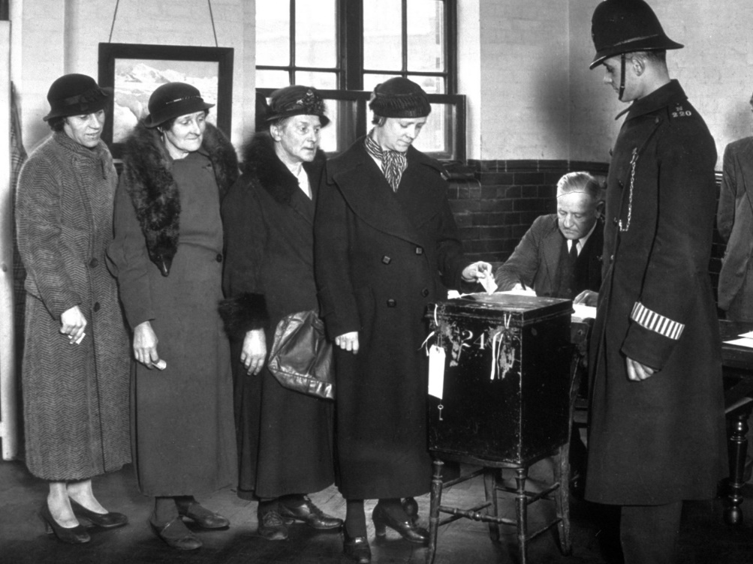
DIFFERENCES OF SEX
We turn now to Mill’s The Subjection of Women
Differences of sex are ‘as entirely irrelevant to political rights, as difference in height, or in the colour of the hair’
Has in essence been conceded by modern (C19th) society, as women now hold property, educated, etc
Would even require suffrage if they were subordinate

Slide 21
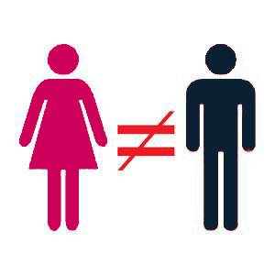
THE SUBJECTION OF WOMEN
Mill’s main thesis: ‘the principle which regulates the existing social relations between the two sexes – the legal subordination of one sex to the other – is wrong in itself, and now one of the chief hindrances to human improvement; and that it ought to be replaced by a principle of perfect equality, admitting no power or privilege on the one side, nor disability on the other’.

Slide 22
ORIGINS
If subjection of women had arisen as conscientious comparison if effects of different arrangements, we might say it would then have been justified. But:
Conditions may’ve changed
No trial made of alternative systems
Subjection arose from mere physical strength and will of men, which was then recognized by law

Slide 23
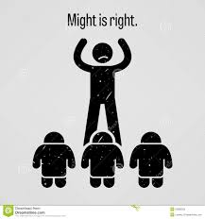
SLAVERY
In earlier times most men were slaves
Slavery of men removed, that of women moderated.
Hence no presumption in favour of subjection from the custom’s mere survival. Women’s inferior position ‘has not lost the taint of its brutal origin’.
Customs derived from ‘law of the strongest’ firmly defended by beneficiaries (even vs. the Church)
Power has to shift - not yet happened for women

Slide 24
COMPARISON WITH DESPOTISM
Despotism still practiced on the continent
This despite the fact that all but despot humiliated
Subjection of women, by contrast, offers ‘gratification of pride’ to ‘whole male sex’
Not abstract or contended for by factions, but ‘comes home to the person and hearth’
Desire for power over those nearby is strongest
Uprising also difficult – women are subject to close surveillance, bribery, threat by male family members

Slide 25
ARGUMENTS FOR SUBJECTION
Subjection ‘natural’ – same was said of all domination, e.g. slavery, even by likes of Aristotle
Subjection ‘voluntary’:
(1) Many women DON’T accept it – they protest
(2) Would be more protest but complaints=punishment
(3) Enslavement of minds – men want not just service but sentiments of women

Slide 26
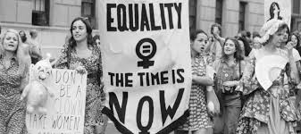
EQUAL RIGHTS
Rights over the person
Property rights
Household rights
Custody of children
Right of divorce
Right of education
Jobs and opportunities
Political rights

Slide 27

PROGRESSIVE HUMAN SOCIETY
‘What is the peculiar character of the modern world[?] … It is, that human beings are no longer born to their place in life, and chained down by an inexorable bond to the place they were born to, but are free to deploy their faculties… to achieve the lot which may appear to them most desirable’.
‘this relic of the past is discordant with the future, and must necessarily disappear’.

Slide 28

Next Lecture: Course Overview/Review

